Slide 1
量子力学的基本假设
H = T + V
如果势能算符简单
“一维定态，氢原子问题”，解析求解
势能算符复杂
近似方法（变分）
简单分子轨道理论
反对称波函数
中心场近似
Hartree-Fock
微扰

Slide 2
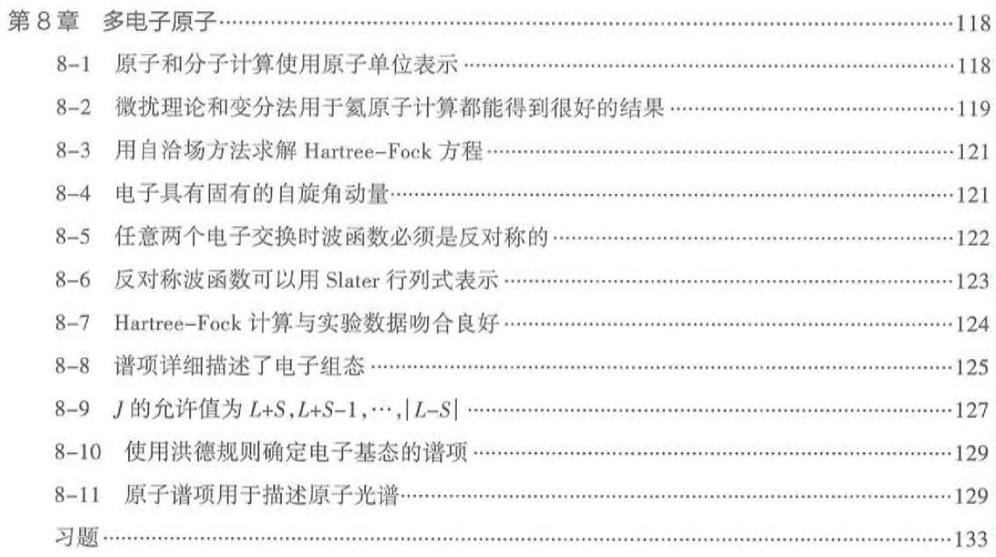

Slide 3
7. Treatments of multi-electron systems
Let’s summarize the steps so far in calculations of electronic structure:
Born-Oppenheimer approximation (clamped nuclei) to separate electronic from nuclear motion.
Independent-electron approximation (central-field approximation in the case of atoms): each electron moves in a potential which is an average of the interactions with the other electrons. Quantitative calculations via the Self-Consistent Field (SCF) method (make the wavefunction antisymmetric with respect to exchange)

Slide 4
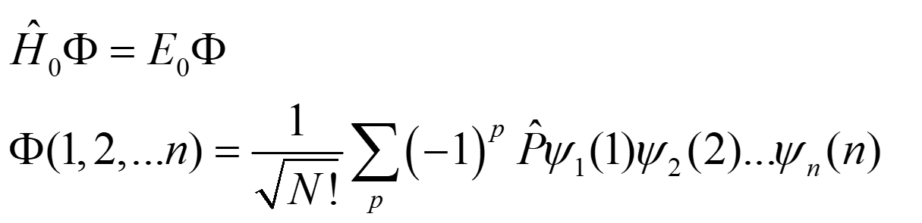
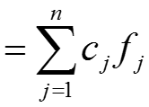
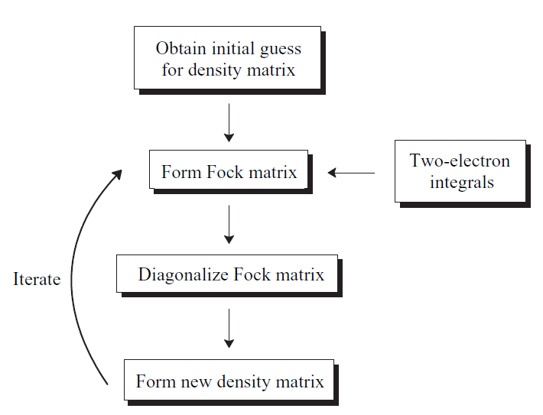
The most important issue in independent-particle approximation is how to construct Vi.
The eigenfunction of Hamiltonian H₀ (independent-particle approximation) can be expressed as Slater determinant.
LCAO-MO:
ψ

Slide 5
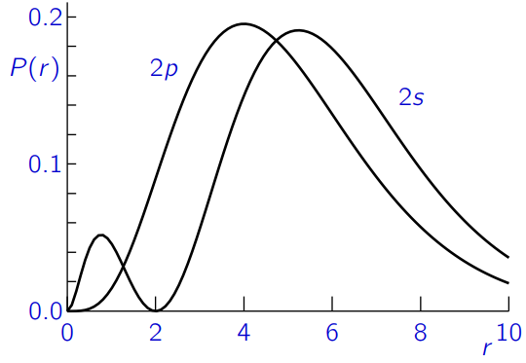
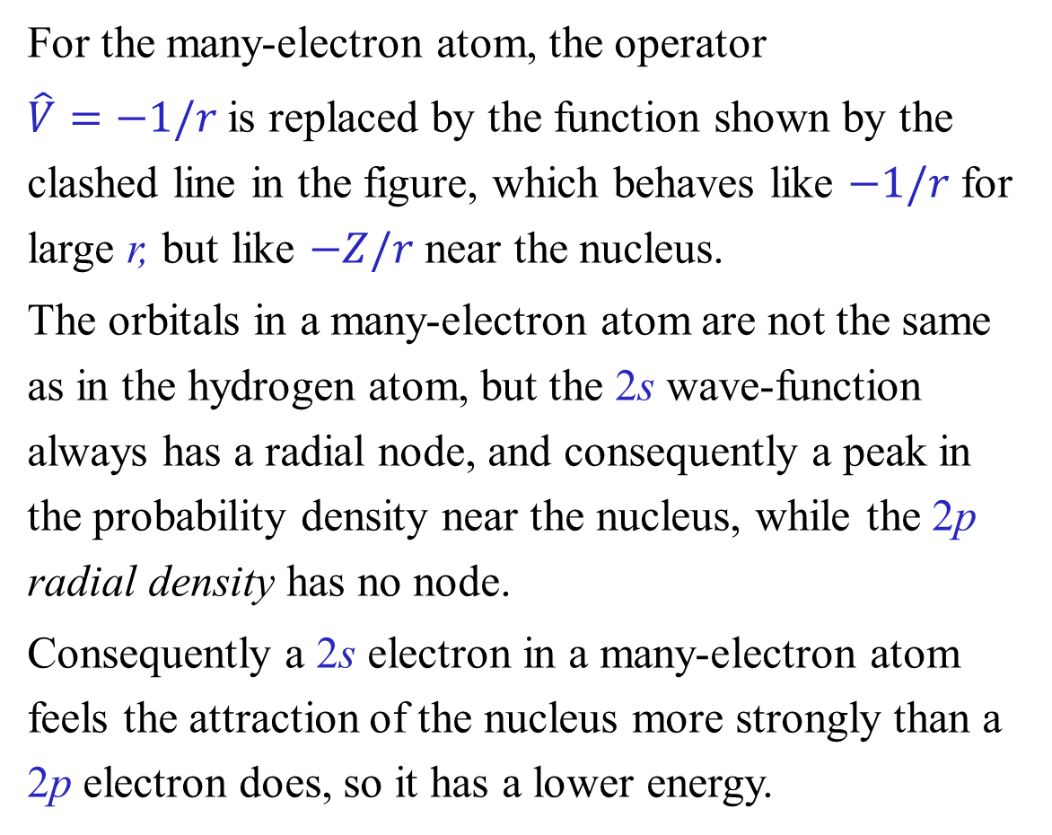
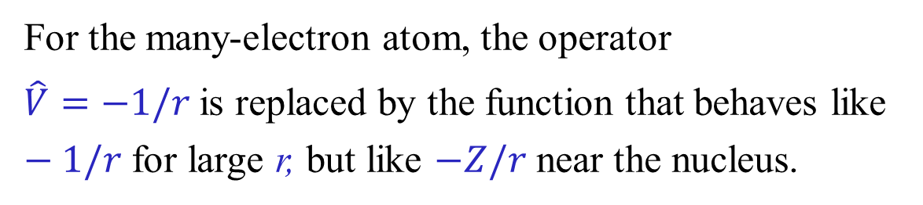
Orbital energies in many-electron atoms
For the many-electron atom, the operator
$\hat{V}=−1/r$is replaced by the function that behaves like $−1/r$ for large r, but like $−Z/r$ near the nucleus.
在多电子原子中，轨道的性质与氢原子不同，但2s波函数始终存在一个径向节面，因而在原子核附近出现概率密度的峰值；而2p径向密度函数则没有节面。 因此，多电子原子中的2s电子比2p电子更强烈地感受到原子核的吸引作用，导致其能量更低。
第六章：变分法研究核有效电荷

Slide 6
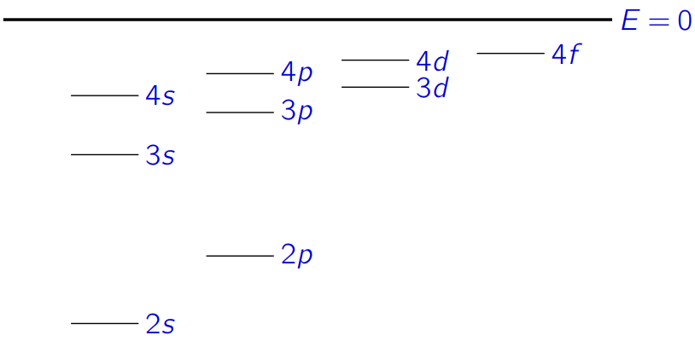
A 2p electron is more effectively screened from the nucleus by the other electrons than a 2s electron, or equivalently the 2s electron penetrates through the other electrons to the nucleus more effectively than the 2p.
Either way, the 2s orbitals have lower energy than the 2p, and the difference in energy increases as we go across the period from Li to Ne.
The same thing happens in each row of the periodic table, so the orbital energy level pattern becomes something like the following (omitting the 1s level):

Slide 7
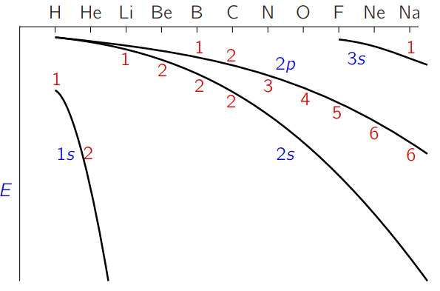
The energy difference between 2s and 2p increases quite sharply:

Slide 8
The building up principle and the electronic configurations
For ground state
a. Pauli exclusion principle: every orbital may contain only two electrons of opposite spins.
The principle of minimum energy: Whilst being compatible with the Pauli principle, electrons occupy the orbital with the lowest energy first.
Hund's First Rule: for the ground configuration of an atom, the term that is lowest in energy has the maximum possible S
多电子原子波函数如何表征？

Slide 9
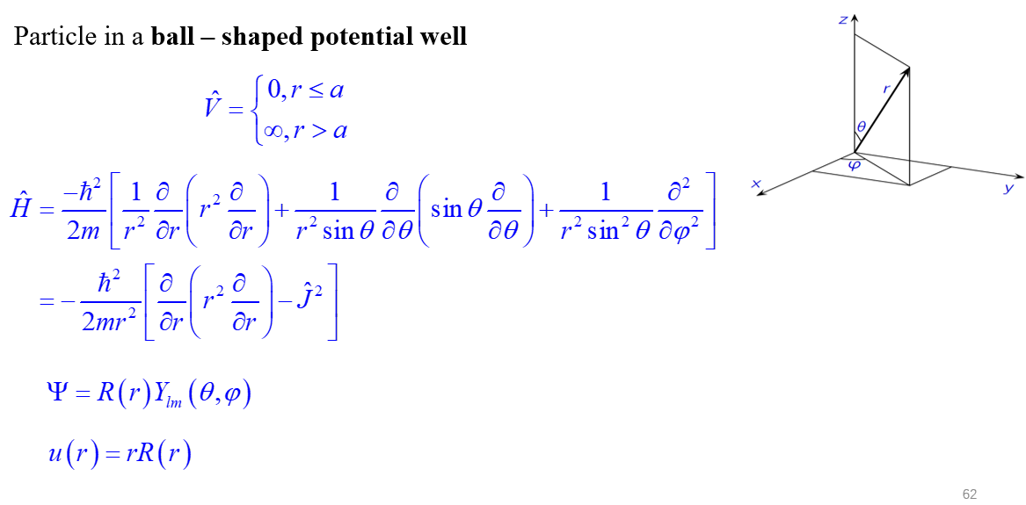
尽管多电子原子中存在复杂的电子-电子排斥，在中心力场 近似下，原子核产生的库仑势是球对称的，这使得整个体系的总哈密顿量具有球对称性。
如果一个系统的哈密顿量具有球对称性，那么它与 L² 和 Lz 对易，L² 和 Lz 的本征值（即量子数 L 和 M_{L}）在时间演化中是守恒的，哈密顿量与L² 和 Lz 有共同的本征函数，哈密顿量的本征函数特征可以用其表征。

Slide 10
Configurations
subshell
(n₁l₁)^{x1}(n₂l₂)^{x2}…(n_{k}l_{k})^{xk}
A configuration of an atom or molecule simply specifies which orbital shells contain electrons. It comes from independent-particle approximation.
For the He atom, the ground (lowest-energy) configuration is 1s²; the excited configurations include ls2s and ls2p. The ground configuration of the C atom is ls²2s²2p².
For closed shell, there is only one pattern:
For open shell, the number of the filling patterns:

Slide 11
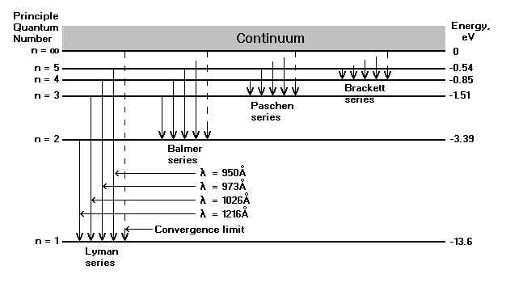
7.2 Atomic Spectra
The spectrum of atomic hydrogen
The state of an electron in a hydrogen atom is specified by three quantum numbers, n, l, and m_{l} and its energy is given by
From hydrogen to multi-electrons atom?

Slide 12
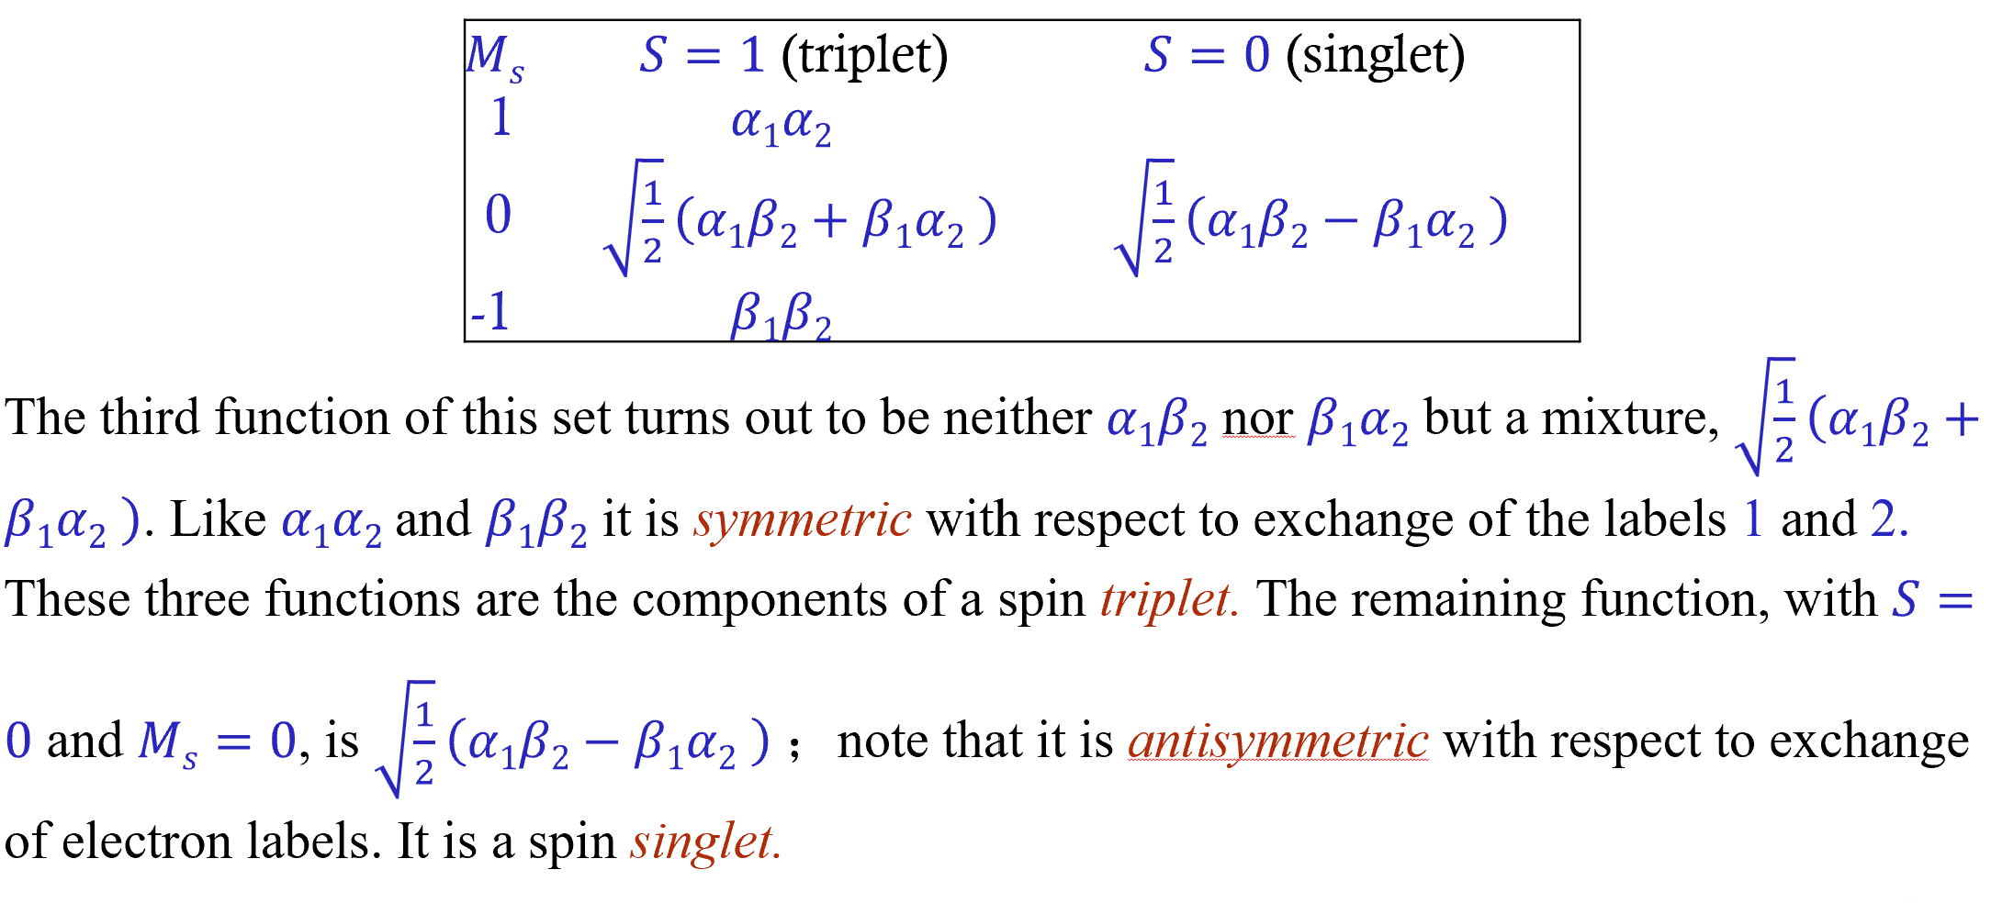
尽管电子间的排斥并不直接影响自旋，但单独考虑单个电子的自旋没有意义。只能使用总自旋角动量，并用量子数S 和 M_{S}来描述。

Slide 13
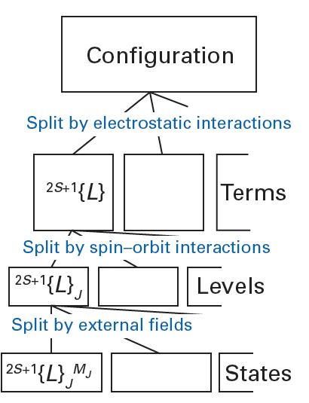
电子-电子相互作用打破了氢原子中l的简并性：对于给定的n，l值越高的状态能量往往越高（因为l越高意味着角动量越大，这样的电子往往离原子核更远，因此内层电子倾向于“屏蔽”原子核）
在真实的原子中，电子相互作用，可以交换轨道角动量。其结果是，单个电子的轨道角动量不再具有确定的量值，我们只能通过量子数 L 和M_{L}来考虑总轨道角动量
电子排布将电子描述为：在由所有其他轨道产生的平均场中，每个电子独立地在轨道上运动。
In the independent-electron picture of an atom, each electron has well-defined angular momentum quantum numbers l, m_{l}, s and m_{s}.

Slide 14
Configurations, terms and levels
组态、谱项、能级
原子或分子的电子组态仅用于确定哪些电子壳层中存在电子。对于氦原子，其基态（能量最低）组态为1s²；激发态组态则包括1s2s和1s2p。碳原子的基态组态为1s²2s²2p²。
电子同时具有轨道角动量和自旋角动量。总轨道角动量记为L；作为角动量，它对应量子数L和M_{L} ，其中M_{L}的取值范围为L, L - 1,…, -L 。由于轨道波函数必须是单值的，这些量子数均为整数。同理，体系存在总自旋S ，对应量子数S 和M_{S} 。 S与L的特定取值共同定义了一个谱项。

Slide 15
The total electronic spin angular momentum
The total electronic spin angular momentum S of an n-electron atom is defined as the vector sum of the spins of the individual electron:
For a fixed S value, the quantum number M_{S} takes on 2S+1 values ranging from –S to S.
Example: Find the possible values of the quantum number S for states of carbon atom that arise from the electron configuration 1s²2s²2p3d.
Solution:
1s electrons: M_{s} = + ½ - ½ =0
2s electrons: M_{s} = + ½ - ½ =0
2p electrons: m_{s} = ½ 3d electrons: m_{s} = ½
Addition of two angular momenta rule
S = 1, 0

Slide 16
The total electronic orbital angular momentum
The total electronic orbital angular momentum of an n-electron atom is defined as the vector sum of the angular momenta of the individual electron:
The total-electronic-orbital-angular-momentum quantum number L of an atom is indicated by a code letter:
L 0 1 2 3 4 5 6 7
Letter S P D F G H I K
For a fixed L value, the quantum number M_{L} (M_{L}ħ---the z component of the total electronic orbital angular momentum) takes on 2L+1 values ranging from –L to L.

Slide 17
Orbital symbol
l 0 1 2 3 4 5 6 7
Letter s p d f g h i k
Term symbol
L 0 1 2 3 4 5 6 7
Letter S P D F G H I K
M_{L} = -L, -L+1, …, L
(2L + 1)

Slide 18
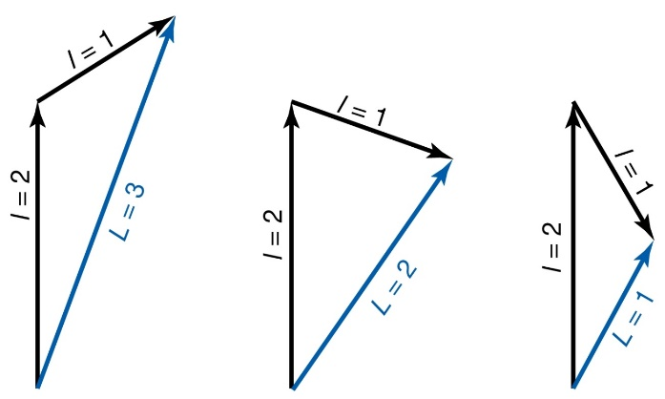
Example: Find the possible values of the quantum number L for states of carbon atom that arise from the electron configuration 1s²2s²2p3d.
Solution:
d¹p¹
Angular momentums are vectors
s l=0
p l=1
d l=2
The total-orbital-angular-momentum quantum number ranges from 1+2 = 3 to |1-2| = 1
L = 3, 2, 1

Slide 19
Term symbols
A given electron configuration gives rise in general to several different atomic states.
2S + 1
L
The degeneracy: (2L + 1)(2S + 1)
Electron-spin multiplicity: 2S + 1
This information is presented in the form of a term symbol.
The central item represents the quantum number L, but it is expressed as a letter: S, P, D, F, etc., for L= 0, 1, 2, 3, etc. It is conventional to use lower-case letters for one-electron properties and upper-case for many-electron properties, and these letters follow the scheme used for one-electron orbital angular momenta

Slide 20
Derivation of Atomic Terms
Configurations of Completely filled subshells
M_{S}=Σ_{i}m_{si} =0 --→ S=0
M_{L}=Σ_{i}l_{i} =0 --→ L=0
Only one term: ¹S
Nonequivalent electrons.
(2p)¹(3p)¹
We need not worry about any restrictions imposed by the exclusion principle
l₁=1, l₂=1 L= 2, 1, 0
m_{s1} = ½ m_{s2} = ½ S=1, 0
³D, ¹D, ³P, ¹P, ³S, ¹S
terms

Slide 21

1+1=2
c. Equivalent electrons : 1s²2s²2p²
2
0
1/2+（-1/2）=0
1
1
1
0
1/2+1/2=1
Equivalent electrons have the same value of n and the same value of l. Two electrons should avoid to have the same four quantum numbers.
1
0
0
1
1+0=1
0
0
0
0
0
0
1
-1
0
-1
-1
1
-1
0
-1
0
-1
-1
-2
0

Slide 22
从M_{L}列中选出最大的M_{L}，它有2L +1 个分量，这些分量属于相同的谱项
从M_{S}列中，选出与上述M_{L}值对应的最大的M_{S}，这就是该谱项的S值，它有2S+1个分量
把上述所有可能的(2L+1)(2S+1)个微观状态挑出来
如果某些微观状态的M_{L}和M_{S}的值一样，任选一个
从剩下的微观状态中重复1-4步，得到另一个谱项。
一般情况下，谱项与微观状态并非一一对应的关系，如果若干个微观状态的M_{L}和M_{S}的值一样，它们的线性组合分属于不同的谱项。
这15个行列式，大部分不是自旋匹配的本征函数！行列式是总Sz的本征函数，但可能不是总S²的本征函数。

Slide 23
Excited ls2s configuration of He atom
The 1s² configuration of the He atom has only one possible state, a singlet, so we consider the excited ls2s configuration to explore the energy differences between singlet and triplet.
1. 有几个微观状态？
2. 谱项？
3. 谱项对应的波函数？

Slide 24
For the ls2s configuration, the possible states are the spin singlet, for which the orbital function is symmetric:
and the spin triplet, for which the orbital function is antisymmetric:
Ψ_{singlet}
¹S
Ψ_{triplet}
³S

Slide 25

微状态
m_{l}
1 0 -1
2
0
¹D
2
0
1
1
1
1
0
0
¹D
1
0
0
1
0
0
¹D
0
0
0
0
0
0
¹D, ³P, ¹S
5 9 1 -> 15
1
-1
0
-1
-1
1
-1
0
-1
0
¹D
-1
0
-1
-1
-2
25
-2
0
0
¹D

Slide 26
Examples
sp²
p²
s
L = 0, S =1/2
¹S, ³P, ¹D
L=0, S =0 | L=1, S=1| L=2, S=0
²S, ²P, ⁴P, ²D

Slide 27
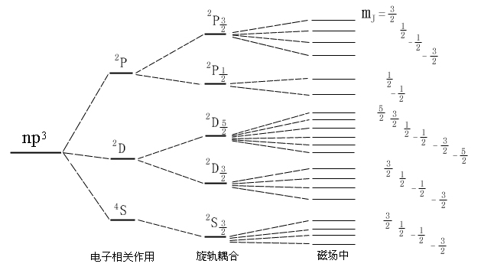
Ground terms of atoms
由同一组态产生的谱项中，S 最大的谱项能量最低；对于 S 相同的谱项，L 最大的能量最低。
1. 为什么最大 M_{S}（即最大 S）能量更低？：交换相互作用。
2. 为什么最大 M_{L}（即最大 L）能量更低？：电子相关。最大 L 的态，对应于一种电子空间运动模式，其中价电子由于高的角动量而彼此保持距离，从而最小化了它们之间的库仑排斥能。
np³ ⁴S , ²D, ²P
p² : ³P, ¹D, ¹S

Slide 28
从变分和微扰理解原子谱项
零级近似：中心场近似（Hartree-Fock），给出了电子组态和高度简并的能级，每个电子都在这个中心场中独立运动，单粒子零级哈密顿的本征函数单电子轨道
零级波函数：N个电子体系的零级波函数是这些单电子轨道构成的Slater行列式， 一个Slater行列式只是众多可能排布状态之一。电子可以以不同的方式填充磁量子数和自旋磁量子数，从而产生多个具有相同零级能量 E₀的Slater行列式
定义微扰算符: Ĥ’ = Ĥ – Ĥ₀ （板书）
通过对角化微扰矩阵，在一级近似下就解除了大部分简并（块对角化）。对角化的结果会自然地将简并态分组。每一组对应一个特定的L和S组合，即一个光谱项²ˢ⁺¹L

Slide 29
Spin-orbit coupling and level splittings
一个谱项中的各个能级会因自旋-轨道耦合效应而存在微小的能量差异。这种相互作用源于每个电子的磁矩（与其自旋方向成正比）与其自身轨道运动之间的耦合。体系倾向于让每个电子的自旋方向与其自身轨道角动量方向相反：对于未达半满的电子层，总角动量量子数J最小的能级能量最低；对于超过半满的电子层，总角动量量子数J最大的能级能量最低。（洪特第三规则）。
The spin-orbit coupling is not described by the Schrodinger Hamiltonian, because it is relativistic in origin, but we can add it in.

Slide 30
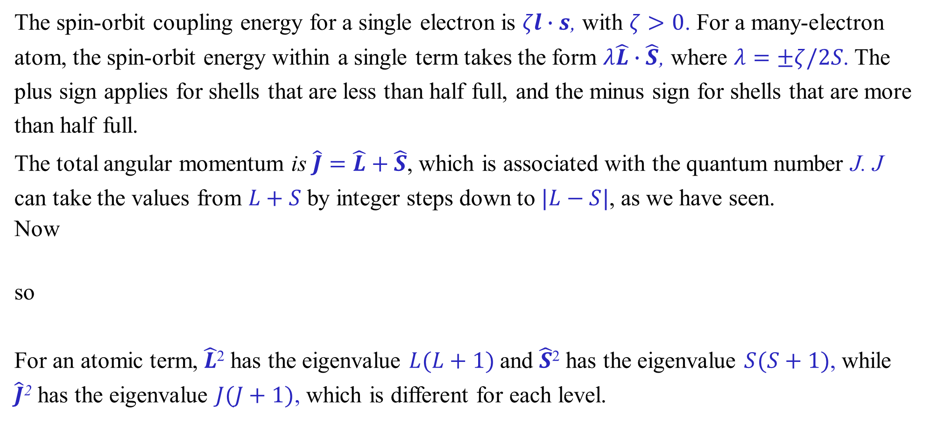
Spin-orbit coupling
The spin-orbit coupling energy for a single electron is $ζl∙s$, with $ζ>0$. For a many-electron atom, the spin-orbit energy within a single term takes the form $λ\hat{L}∙\hat{S}$, where $λ=±ζ/2S$. The plus sign applies for shells that are less than half full, and the minus sign for shells that are more than half full.
The total angular momentum is $\hat{J}=\hat{L}+\hat{S}$, which is associated with the quantum number J. J can take the values from $L+S$by integer steps down to $|L−S|$, as we have seen.
Now
so
For an atomic term, $\hat{L}$² has the eigenvalue $L(L+1)$and $\hat{S}$² has the eigenvalue $S(S+1)$, while $\hat{J}$² has the eigenvalue $J(J+1)$, which is different for each level.

Slide 31
Ĥ₀ still can not interpret the atomic spectrums.
We must consider the high-level Hamiltonian
Ĥ = Ĥ₀ + Ĥ_{SO}
Ĥ₀ commutes with L_{Z} and with S_{Z}, but Ĥ does not

Slide 32
在考虑LS耦合情况下，L_{Z}和S_{Z}不再是好的量子数所对应的算符，而(L_{Z}+S_{Z})与哈密顿算符对易。

Slide 33
H₀, L², L_{Z}
have the common eigenfunctions
S², S_{Z}
have the common eigenfunction
H₀, L², L_{Z}, S², S_{Z}
have the common eigenfunction
H（H₀+ L·S）, L², S², J², J_{z}
have the common eigenfunctions, l,s, j, m_{j} are the good quantum numbers

Slide 34
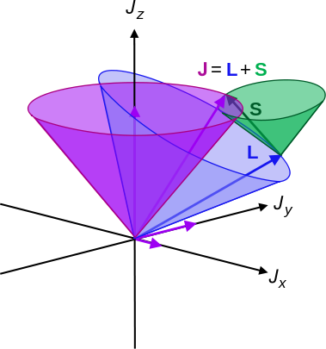
The total angular momentum
J = (L + S), (L+ S) –1,… ⎢L- S ⎢
Spin – orbit coupling
^{2S+1}L_{J}
total angular momentum quantum number J
The quantum number J associated with the total angular momentum can take the values $L+S, L+S−1$, ..., down to $|L−S|$. The values of L, S and J define a level.
For example, the B atom has the configuration ls²2s²2p. Completely filled shells have total angular momentum zero, so we need only consider the 2p electron. It has l = 1 (so L = 1, symbol P) and s $=\frac{1}{2}$ (so S $=\frac{1}{2}$ and the multiplicity is 2 — a doublet). J can be $L+S=\frac{3}{2}$or $L+S−1= |L−S|=\frac{1}{2}$. There are two levels, with term symbols $2P_{1/2}$ and $2P_{3/2}$.

Slide 35
Example: Find the possible values of the total-angular- momentum quantum number resulting from the addition of two angular momenta with quantum number j₁ = 2 and j₂ = 3 .
Solution: j₁+j₂=2+3=5
|j₁-j₂|=|2-3|=1
The possible J values are: 5, 4, 3, 2, 1
Example: Find the possible values of the total-angular- momentum quantum number resulting from the addition of two angular momenta with quantum number j₁ = 2 and j₂ = 3/2 .
Solution: j₁+j₂=2+3/2=7/2
|j₁-j₂|=|2-3/2|=1/2
The possible J values are: 7/2, 5/2, 3/2, 1/2

Slide 36
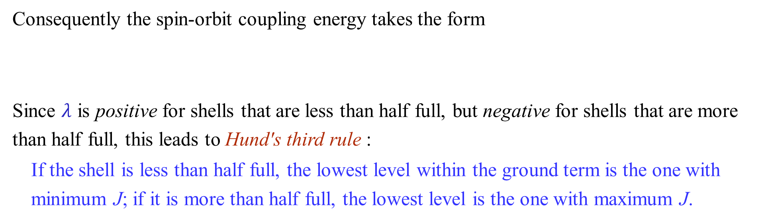
Hund's third rule and the Landé interval rule
Consequently the spin-orbit coupling energy takes the form
Since $λ$ is positive for shells that are less than half full, but negative for shells that are more than half full, this leads to Hund's third rule :
If the shell is less than half full, the lowest level within the ground term is the one with minimum J; if it is more than half full, the lowest level is the one with maximum J.
The scalar product S·L is negative if the spin and orbital angular momentum are in opposite directions. Since the coefficient of S·L is positive, lower J is lower in energy.

Slide 37
This result also leads to the Landé interval rule: the splitting between adjacent levels is proportional to the higher J value:
The spin-orbit coupling constant $λ$ increases sharply with atomic number; for instance it is about 270 cm⁻¹ for F, 586 cm⁻¹ for Cl and 2460 cm⁻¹ for Br. If the value is too large, so that the effects of spin-orbit coupling are comparable with those of electron repulsion, the treatment given here (known as Russell-Saunders coupling) is inappropriate.

Slide 38
(1) 在不违反泡利原理前提下，将电子填入轨道，使每个电子m_{s}尽可能大，m_{l}也尽可能大；
(2) 求出所有电子的m_{s}之和作为S，m_{l}之和作为L；
(3) 对少于半充满组态，取J=|L-S|；对多于半充满组态，取J=L+S。
nd³
L=3, S=3/2 -> ⁴F_{3/2}
2 1 0 -1 -2
np⁴
L=1, S=1 -> ³P₂
1 0 - 1

Slide 39
Example: Why does Cu Kα radiation ( X-ray ) consist of Kα₁ and Kα₂ radiations?
Ground state
1s² 2s² 2p⁶3s²…..
Excited state
1s¹ 2s² 2p⁶3s²…..
1s¹ ²S_{1/2}
X-ray Kα radiation
1s² 2s² 2p⁵3s²…..
2p⁵ ²P_{1/2} ²P_{3/2}
1s¹ ²S_{1/2}
Kα₂
Kα₁
2p⁵ ²P_{1/2} ²P_{3/2}

Slide 40
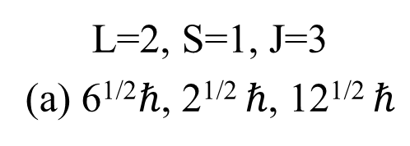
Examples
For a state belong to ³D₃ level, give the magnitude of
The total electronic orbital angular momentum
The total electronic spin angular momentum
The total electronic angular momentum
L=2, S=1, J=3
(a) 6^{1/2}$ℏ$, 2^{1/2} $ℏ$, 12^{1/2} $ℏ$

Slide 41
H = H₀₀ + H’ + H_{S.O.}
configuration
term
level

Slide 42
原子光谱选择定则*
ΔS = 0：自旋多重度不变。（单重态-单重态跃迁，三重态-三重态跃迁）
ΔL = 0, ±1 （但 L=0 → L=0 禁阻）
ΔJ = 0, ±1 （但 J=0 → J=0 禁阻）
实验科学家从观察原子光谱中总结出的规律,如何理解？
光谱学本质上就是在测量各种微扰算符（电偶极、磁偶极、四极矩等）的非对角矩阵元，而选择定则就是判断这些矩阵元何时不为零。

Slide 43
在量子力学中，光与物质的相互作用可以被处理为一种含时微扰。两个能级之间的跃迁概率与微扰算符的矩阵元平方成正比.
微扰算符Ĥ' =电偶极算符μ
|<f| Ĥ' |i>|² ∝ |<f| μ |i>|²
跃迁速率满足
跃迁能否发生，取决于电偶极矩算符在初态和末态之间的矩阵元 <f| μ |i> 是否为零。 如果矩阵元为零，跃迁就是禁阻的；如果非零，就是允许的。
Notes:
空间反演操作下是奇函数（μ → -μ）
初态和末态必须具有相反的宇称，矩阵元才可能非零。
矩阵元 <f| μ |i> 必须在所有对称操作下保持不变。μ 是奇宇称，所以为了保持整个矩阵元的宇称为偶（不变），|i> 和 |f> 的宇称必须相反。

